Slide 1
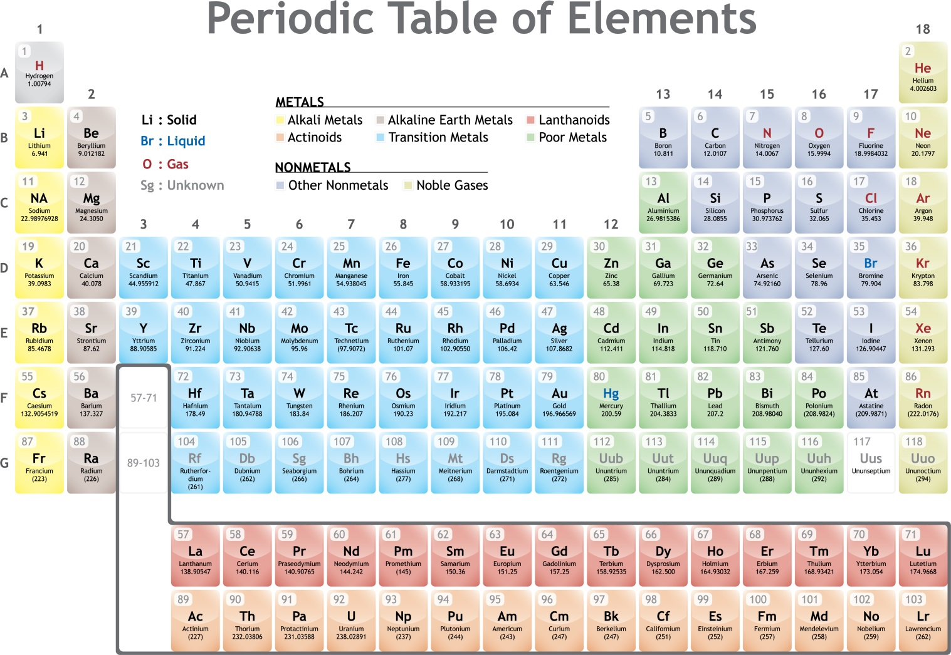
Chapter 6 – The Periodic Table
Augustine.

Slide 2
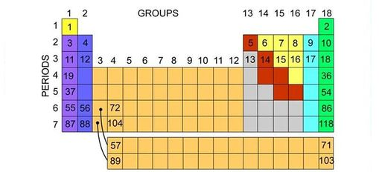
Section 6.1 – Organizing the Periodic Table
Chemists used the properties of elements to sort them into groups.

Slide 3
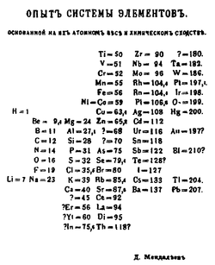
Mendeleev
Mendeleev is credited with creating the first useful periodic table.
He arranged the elements in order of increasing atomic mass.
He also put elements with similar properties in the same group.

Slide 4
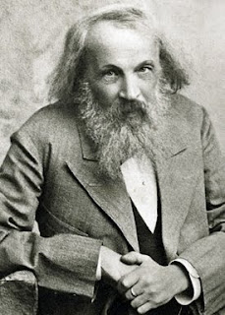
Mendeleev
When he finished, there were blanks in his periodic table.
Since he arranged his periodic table based on properties, he predicted the properties of elements that had not been discovered.
When the elements were discovered, his predictions were right.

Slide 5
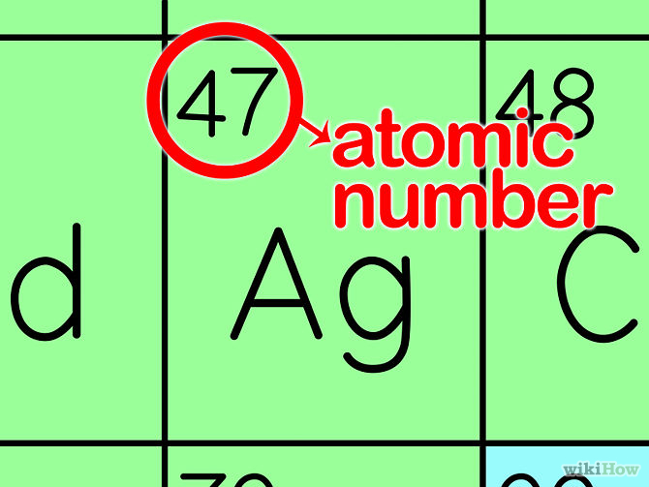
Modern Periodic Table
The modern periodic table is arranged in order of increasing atomic number.
Elements in the same group have similar properties.
Elements in the same period have a repeating set of properties. This is referred to as the periodic law.

Slide 6
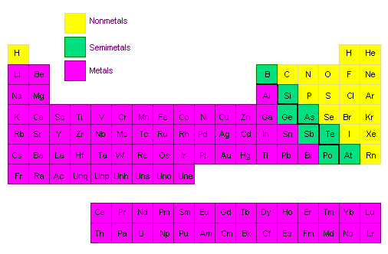

Metals, Nonmetals, and Metalloids
The periodic table can be broken up into metals, nonmetals, and metalloids.

Slide 7
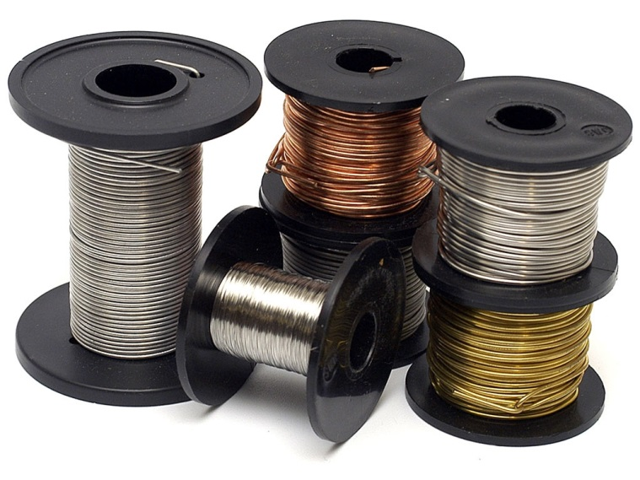
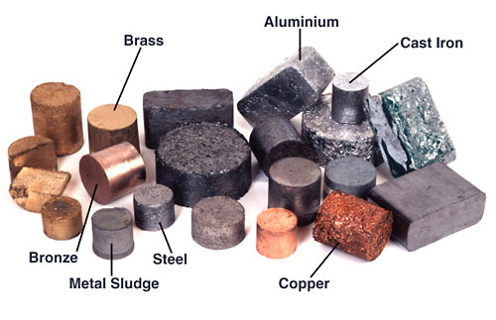
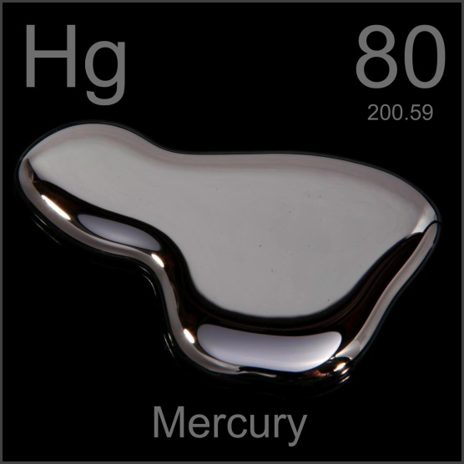
Metals
Properties of metals include:
  Good conductors
  Shiny
  Solid (except mercury)
  Ductile – can be pulled into wires
  Malleable – can be hammered into sheets

Slide 8
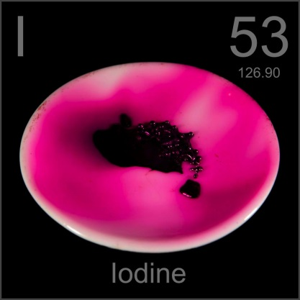
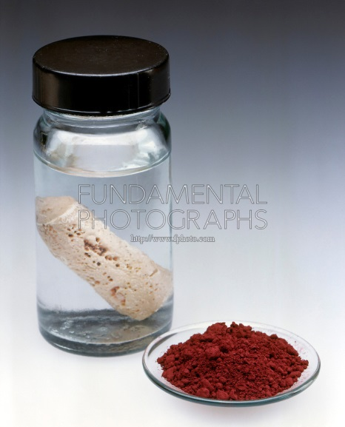
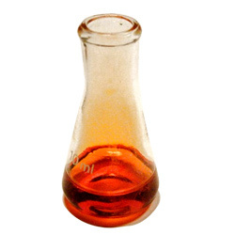


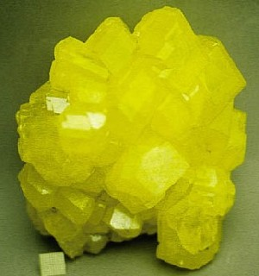
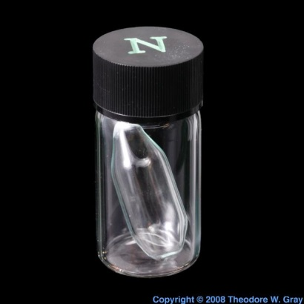
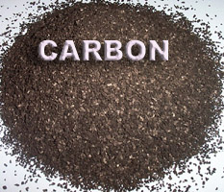
Nonmetals
Properties of nonmetals include:
  Tend to be gases
  Poor conductors (except carbon)
  Brittle
  Dull

Slide 9
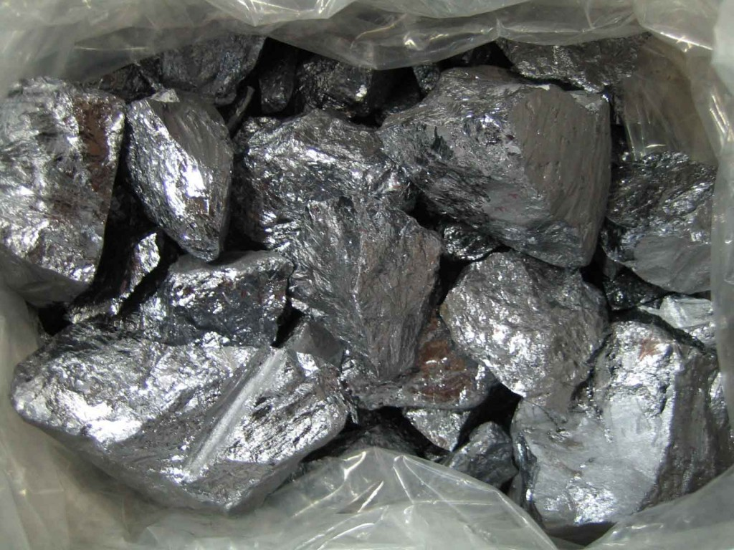
Metalloids
Metalloids generally have some of the properties of metals and nonmetals.

Slide 10
Section 6.1 Assessment
What property did Mendeleev use to organize his periodic table?
How are elements arranged in the modern periodic table?
Name the three broad classes of elements.
Which of these sets of elements have similar physical and chemical properties ?
a. oxygen, nitrogen, carbon, boron
b. strontium, magnesium, calcium, beryllium
c. nitrogen, neon, nickel, niobium

Slide 11
Section 6.1 Assessment
Identify each element as a metal, metalloid, or nonmetal.
a. gold
b. silicon
c. sulfur
d. barium
Name two elements that have properties similar to those of the element sodium.

Slide 12
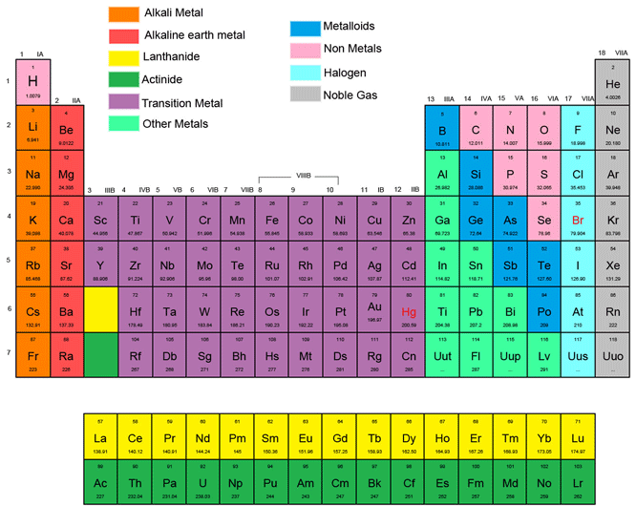
Section 6.2 – Classifying the Elements

Slide 13
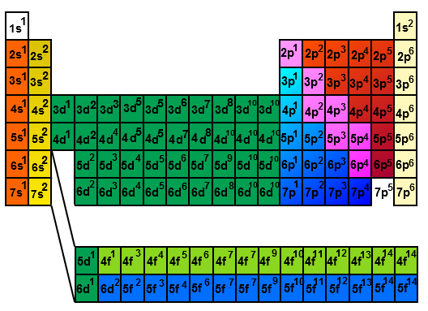
Electron Configuration in Groups
Elements in the same group have similar properties because they have similar electron configurations.

Slide 14
Section 6.2 Assessment
Into what four classes can elements be sorted based on their electron configuration?
Why do the elements potassium and sodium have similar chemical properties?
Which of the following elements are transition metals: Cu, Sr, Cd, Au, Al, Ge, Co?
How many electrons are in the highest occupied energy level of a Group 15 element?

Slide 15
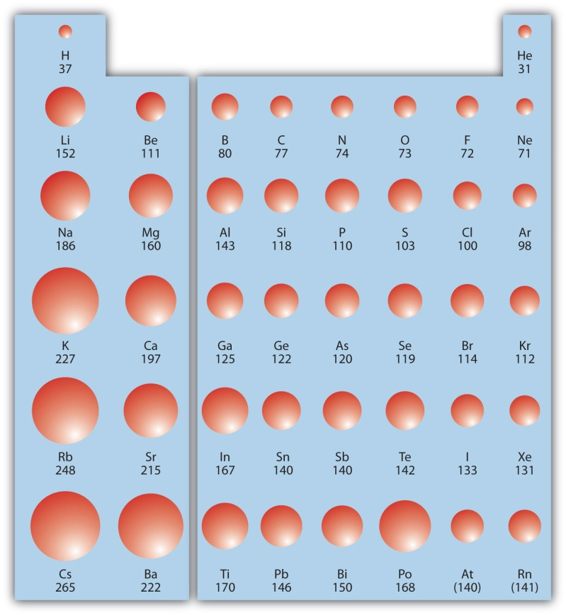
Section 6.3 – Periodic Trends
Atomic Radius – the radius of an atom.
In general, the atomic radius increases as you move down a group and decreases as you move across a period.

Slide 16
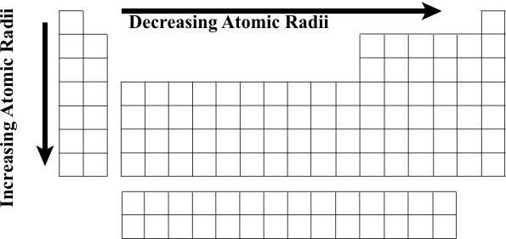
Atomic Radius
The atomic radius increases going down a group because larger energy levels are added with each row.
The atomic radius decreases going across a period because electrons are added to the same energy level, but protons are added to the nucleus which pull the electron in closer.

Slide 17
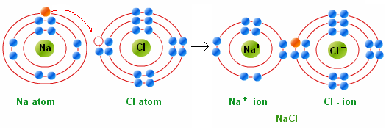
Ions
An ion is an atom with a charge. An atom has a charge when it gains or loses electrons.
An anion is a negative ion (gains electrons).
A cation is a positive ion (loses electrons).

Slide 18
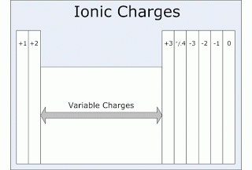
Charges
You can tell the charge of an element based on which group it is in on the periodic table (except for transition metals).

Slide 19
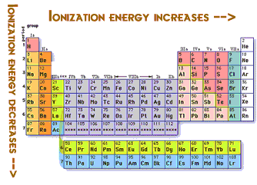
Ionization Energy
Ionization energy is the energy needed to remove an electron from an atom.
In general, ionization energy decreases as you move down a group and increases as you move across a period.

Slide 20
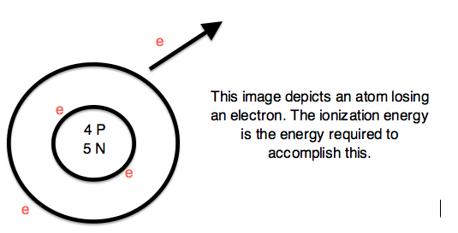
Ionization Energy
Ionization energy decreases as you move down a group because larger energy levels are added which are farther from the nucleus. Since the electrons are far from the nucleus, it takes less energy to remove one.
Ionization energy increases as you move across a period because the nucleus gets stronger, so it takes more energy to remove an electron.

Slide 21
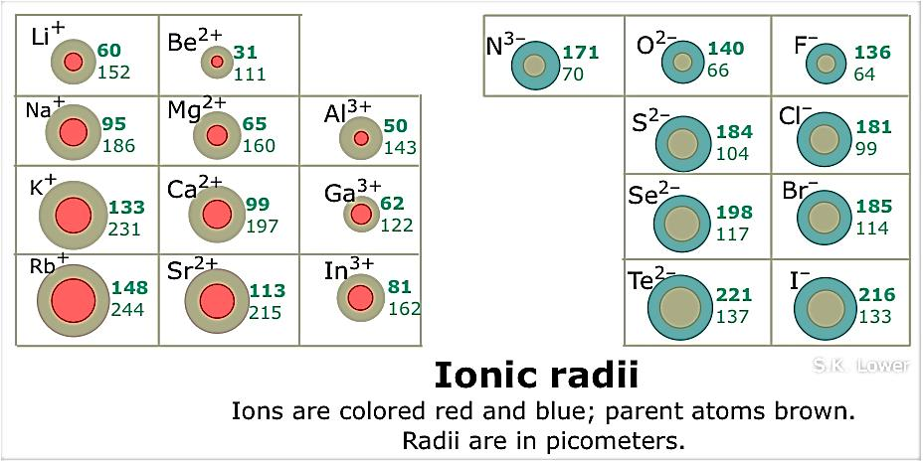
Ionic Size
Ionic radius is the radius of an ion.
Cations are smaller than the parent atom.
Anions are larger than the parent atom.

Slide 22
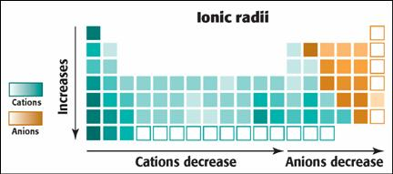
Ionic Size
In general, ionic size increases as you move down a group because larger energy levels are added.

Slide 23
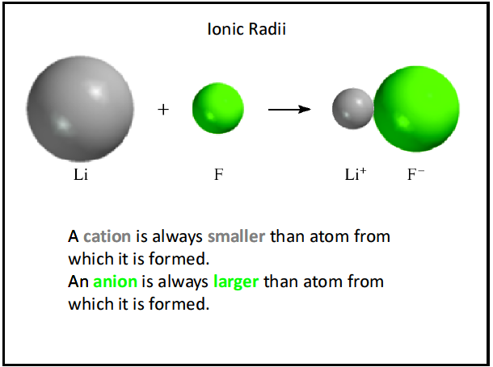
Ionic Size
Ionic size generally decreases across the cations, then increases as you move to the anions. As you move across the anions the size decreases again. This is due to the increased strength of the nucleus and the loss or gain of electrons.

Slide 24
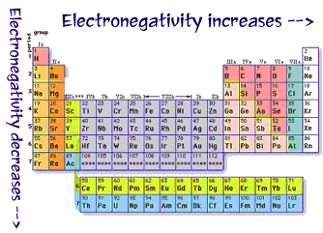
Electronegativity
Electronegativity is the ability of an atom to attract more electrons.
In general, electronegativity decreases as you move down a group and increases as you move across a period.

Slide 25
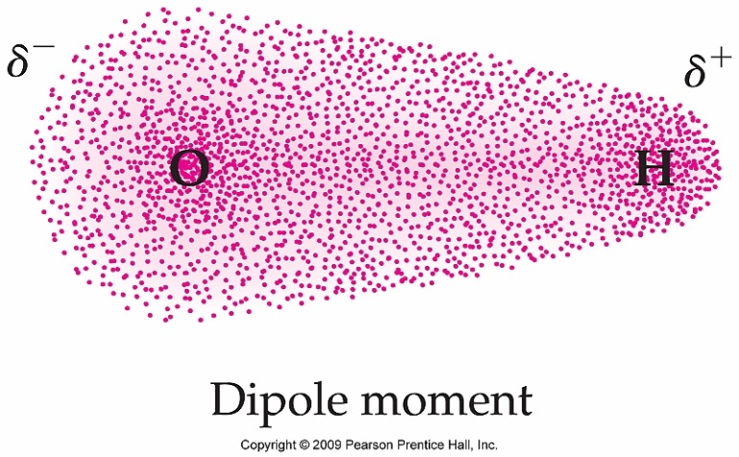
Electronegativity
Electronegativity decreases as you move down a group because larger energy levels are added that are farther from the nucleus so the atom cannot attract electrons as well.
Electronegativity increases as you move across a period because the nucleus is stronger and can attract more electrons.

Slide 26
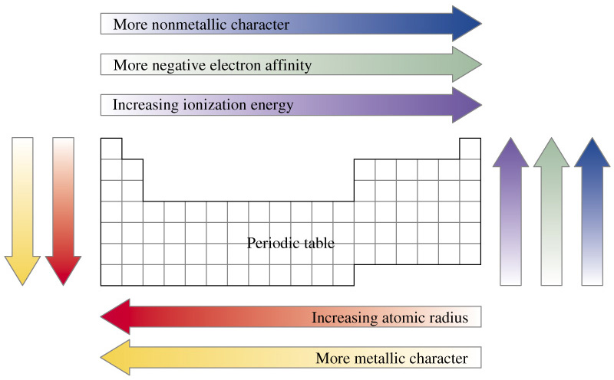
Summary of Trends

Slide 27
Section 6.3 Assessment
How does atomic size change within groups and across periods?
When do ions form?
What happens to first ionization energy within groups and across periods?
Compare the size of ions to the size of the atoms from which they form.
How does electronegativity vary within groups and across periods?

Slide 28
Section 6.3 Assessment
Arrange these elements in order of decreasing atomic size: sulfur, chlorine, aluminum, and sodium. Does your arrangement demonstrate a periodic trend or a group trend?
Which element is each pair has the larger first ionization energy?
a. sodium, potassium
b. magnesium, phosphorus

Slide 29
THE END

